Slide 1
Data science Capstone project – DC Neighborhood
Lisa WU
January 14, 2020

Slide 2
Introduction and business problem
Introduction: Wei Li is moving from Beijing to the Washington DC area, as her daughter is going to the Georgetown University in DC in the coming fall.
Business Problem: Wei is interested in living in a DC neighborhood and explores the DC museums and city activities. She needs help to figure out which neighborhood she should consider. Several other facts about Wei below:
Wei is an avid bike rider, loves cooking and enjoys a variety of cuisines
Wei will not have a car in the first several months and will rely on Uber or public transportation for the most part, so it is important to have easy access to bike trails and shopping centers, etc.
Goals: In this data science project, I will try to use data science tools to explore the relevant data provide analytical insights about the DC neighborhoods which will help Wei to narrow down the neighborhood(s) for considerations.
Interests: Wei will benefit from this analysis. Other people who may be interested in this project could be people who look to move to the DC area in general.

Slide 3
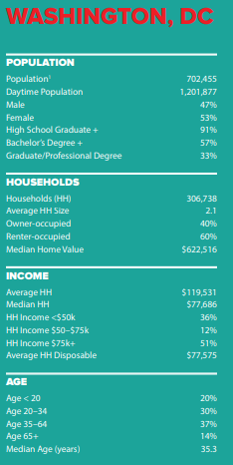
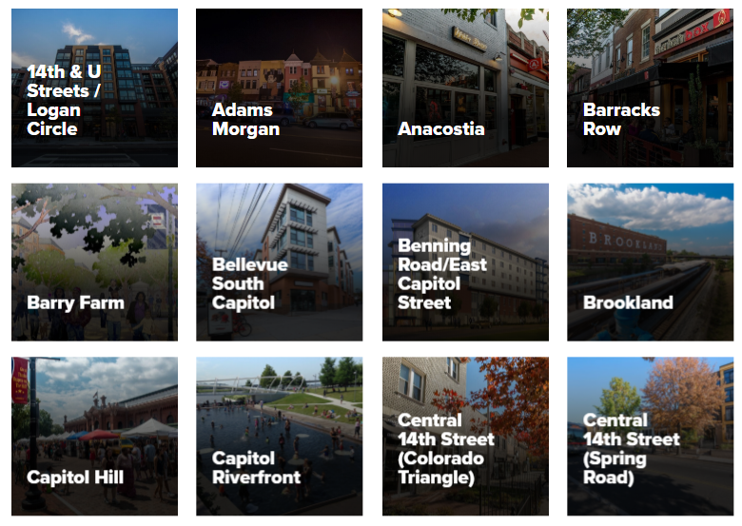
A high overview of Washington DC and neighborhoods
Washington DC is the capital and political center of the US. Unlike any other, DC offers free museums, monuments and memorials, and has 130+ eclectic neighborhoods with unique local flavor. Below is several examples of the large DC neighborhoods
Source: https://14x1z243z988315lc25fjqzl-wpengine.netdna-ssl.com/wp-content/uploads/2017/10/wdcep_np.pdf

Slide 4
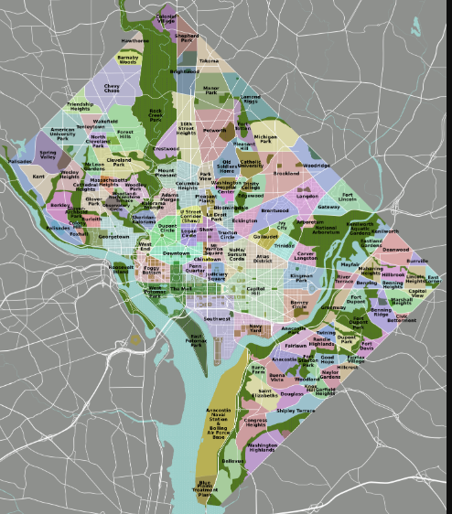
Washington DC neighborhoods Map
Source: https://upload.wikimedia.org/wikipedia/commons/9/93/DC_neighborhoods_map.png

Slide 5
relevant factors Considered in the project
As a start, I gathered the average rent information of the neighborhoods (Slide 6)
Also, based on the definition of the business problem, I think the following four key factors are relevant to evaluate:
Safety of the neighborhood
Easy access to bike trails
Close distance to shopping center(s)
Availability of a variety of venues and restaurants in the neighborhood (any type of restaurant)

Slide 6
Data sources
I obtained the data used in this project from the sources below. I downloaded and update most of the data files to Github (https://github.com/lisawu83/CapstoneProject).
Washington DC and its neighborhood general information (souce: https://washington.org/dc-neighborhoods, https://www.tripsavvy.com/info-on-dc-neighborhoods-4102953)
Washington DC neighborhood names and geo spacial data (source: https://opendata.dc.go ): I will use these information to create a dynamic neighborhood map to help visualize key data
2017 - 2019 Washington DC crime reports (source: https://opendata.dc.go ): This will help evaluate the safety of each neighborhood
Bike trails available in the DC neighborboods (source: https://opendata.dc.go ): This is important information given Wei's passion for biking
Shops in the DC neighborhoods (source: https://opendata.dc.go ): Having shops in or near the neighborhood is critical as Wei loves cooking and shopping
Venues and restaurants in the DC neighborhoods (source: Foursquare API https://developer.foursquare.com/)

Slide 7
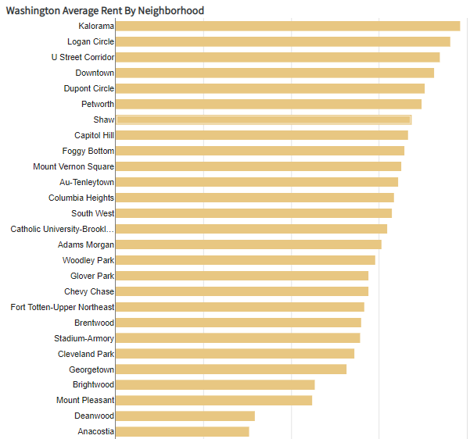
Data insights
$2,944
The graph on the left shows the average rent per month in the DC neighborhoods. The rent will vary depending on different apartment size and bedrooms. In general, the observations are below:
The most expensive Washington neighborhoods to rent apartments in are Kalorama, Logan Circle, and U Street Corridor
The cheapest Washington neighborhoods to rent apartments in are Anacostia, Deanwood, and Mount Pleasant *
Source: https://www.rentjungle.com/average-rent-in-washington-rent-trends/
$1,141

Slide 8
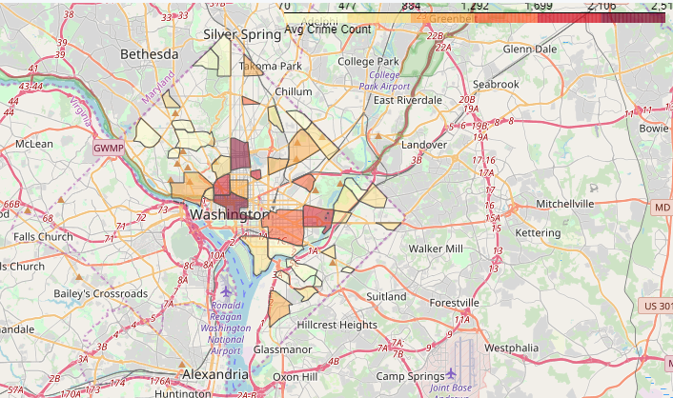
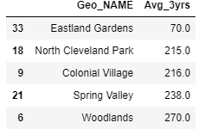
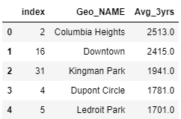
Data insights – Cont’d Evaluate the safety of the neighborhoods
The reported crime incident data is a good indicator of the safety of the neighborhood. I obtained the recent years’ crime incidents reports (2017-2019) for the DC neighborhoods from https://opendata.dc.gov
Obtained the neighborhood geo special data from zillow-neighborhoods.geojson, which I used to create the map below. The darker the color, the higher the crime incidents count in the past 3 years
Top 5 Safest Neighborhood
Bottom 5 Neighborhoods
The northwest neighborhoods and some of the east and south neighborhoods in DC are safer neighborhoods, compared to the downtown areas. Wei will be glad to find out that the neighborhood around the Georgetown University is one of the safer neighborhoods

Slide 9
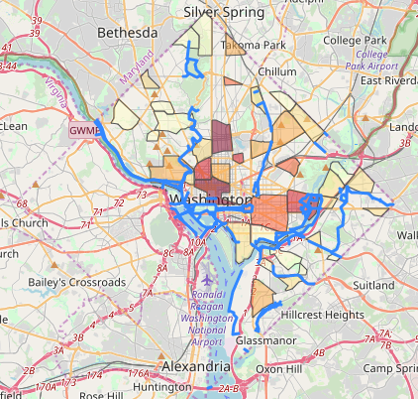
Data insights – Cont’d Bike trails in the neighborhoods
I obtained the bike trails data in the DC neighborhoods from https://opendata.dc.gov and added the trails to the prior map. See the blue lines in the map
There are many trails in the northwest, south and central neighborhoods. This is a good news!

Slide 10
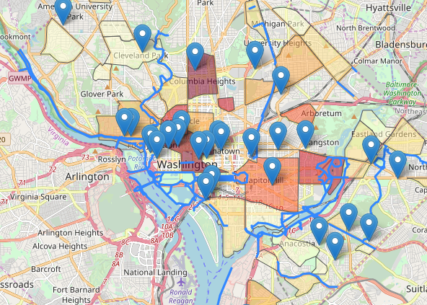
Data insights – Cont’d Shops in the Washington DC neighborhoods
I obtained the shopping center data in the DC neighborhoods from https://opendata.dc.gov and added markers to flag the shopping centers to the prior map. See the popup markers in the map
Based on the shopping center information, except for the neighborhoods in the far north and south end of DC which do not have shopping centers nearby, all other neighborhoods seem to be within reasonable distance of one or many shopping centers.

Slide 11
Data insights – cont’d
After I analyzed the neighborhood safety, bike trials and shopping centers location data, several neighborhoods on the northwest and southeast of DC satisfy all three criteria (safe, bike trail and shopping centers nearby)
Let’s then further review the comprehensive venues information of all neighborhood using Four Square API so we can gain insight of the expected lifestyle of the neighborhoods

Slide 12
Methodology
I will use Four Square to collect venues information for each neighborhood, which will provide further insight what lifestyle Wei should expect for each neighborhood
In the second step, I will sort the venues in each neighborhood so we can understand the top venue types
The final step is to choose a machine learning approach to create clusters of similar neighborhoods based on the top venues in each neighborhood. K-means clustering model is a good choice, as it is an unsupervised machine learning approach and works very well with this kind of case

Slide 13
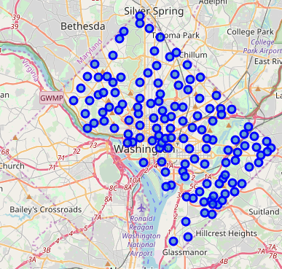
Analysis
I obtained the venue information from Four Square and populated the DC map

Slide 14
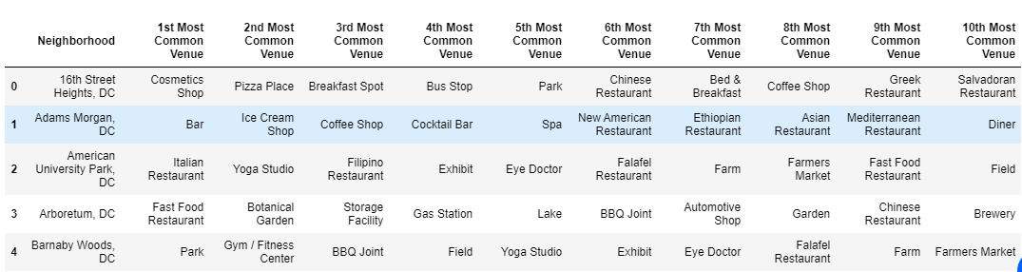
Analysis – Cont’d
I processed the venue data obtained Four Square and gained insight about the top venue types in each neighborhood. See examples of the top 10 venue types of some neighborhoods

Slide 15
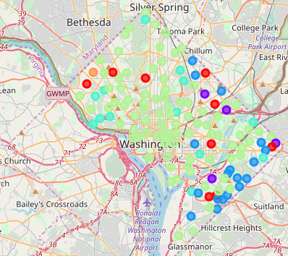
Modeling: Use K-means to cluster neighborhoods
I used K-Means to group the neighborhood into 6 clusters based on the top 10 venue types of each neighborhood

Slide 16
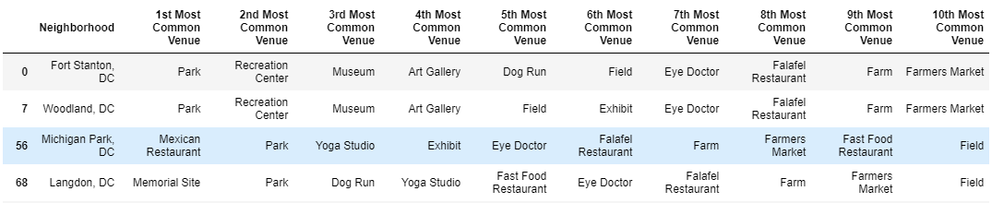
Results and discussion
Cluster #1 (Urban Sub Mix): This cluster has a urban suburban mix feel. There are a lot of parks and other sites to relax and visit. There are also farmers markets in the neighborhood that provide fresh groceries
Some of the neighborhoods in this cluster:

Slide 17
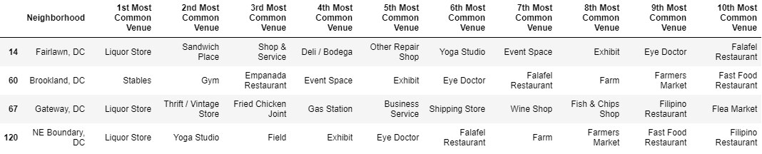
Results and discussion – Cont’d
Cluster #2 (Sub Feel): This cluster offers a suburban feel while close to the center of the city. There are many affordable stores, restaurants and farm/flea markets in the neighborhoods.
Some of the neighborhoods in this cluster:

Slide 18
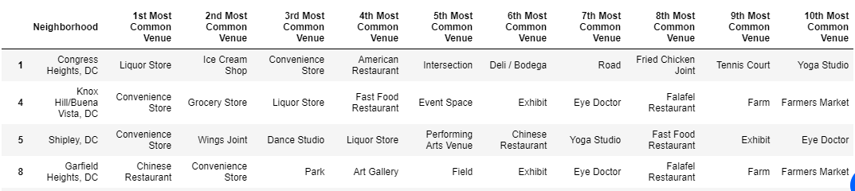
Results and discussion – Cont’d
Cluster #3 (Dense Urban): This cluster offers an urban feel with high population density and relatively small-sized convenience and other stores
Some of the neighborhoods in this cluster:

Slide 19
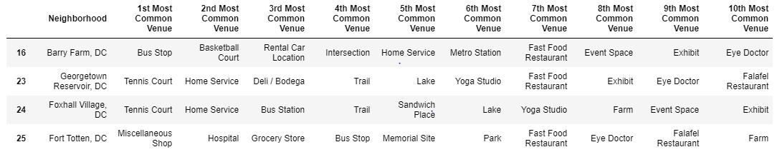
Results and discussion – Cont’d
Cluster #4 (Heaven for Young Professionals): The neighborhoods in this cluster provide a lot of bars, restaurants, coffee shops, and parks. It also has many bus tops, trails, market/farmer markets which offer great convenience. Many young professionals live in these neighborhoods. The public schools in Foxhall Village are highly rated. The home or rent prices for this cluster are at the median level of the DC neighborhoods. The neighborhoods in this cluster could be a great choice, especially if they are also close to the Georgetown University
Some of the neighborhoods in this cluster:

Slide 20
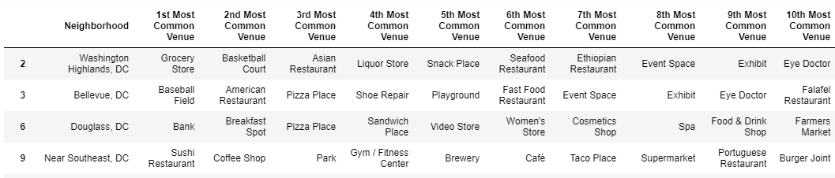
Results and discussion – Cont’d
Cluster #5 (Family Friendly): The neighborhoods in this cluster provide many family-friendly facilities (e.g.g baseball fields, playgrounds, trails) and stores. Not too many restaurant varieties.
Some of the neighborhoods in this cluster:

Slide 21
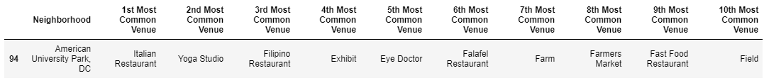
Results and discussion – Cont’d
Cluster #6 (University Life): There is one neighborhood in this cluster. This neighborhood has many universities and schools and has many family-friendly facilities (e.g. doctor office, farmers market and shopping centers)
The neighborhood in this cluster:

Slide 22
Results and discussion – Cont’d
Our analysis shows that Cluster 4 (Heaven for Young Professionals) could be the best candidate for Wei
The neighborhoods in this cluster provide a variety of bars, restaurants, coffee shops, and parks
It also has many bus tops, trails, market/farmer markets which offer great convenience
The home or rent prices for this cluster are at the median level of the DC neighborhoods. This cluster seems to match well to Wei's situation

Slide 23
conclusion
The purpose of this project is to evaluate the top factors (safty, bike trails, shopping centers and venue availability) that Wei will consider in searching for a neighborhood. Based on our analysis, the neighborhoods in Cluster 4 are good candidates for Wei to evaluate further.
Final selection of the neighborhood and an apartment will be made after Wei searches the available apartment listings and schedules onsite visits. Wei will need to evaluate the actual rent, room condition, community facilities and the location of the apartment to make a final decision

